Slide 1
DOMAIN MODEL: ADDING ASSOCIATIONS
Biju R Mohan
Lecture 13

Slide 2
Agenda
Identify associations for a domain model.
Distinguish between need-to-know and comprehension-only associations.

Slide 3
Associations
An association is a relationship between types (or more specifically, instances
of those types) that indicates some meaningful and interesting connection

Slide 4
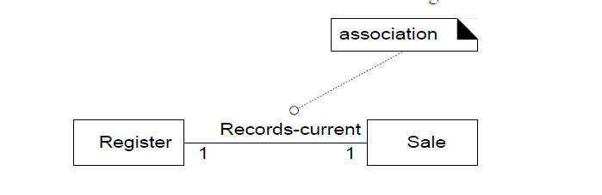
UML Notation of Association

Slide 5
Types
Consider including the following associations in a domain model:
Associations for which knowledge of the relationship needs to be preserved for some duration ("need-to-know" associations).
Associations derived from the Common Associations List.

Slide 6
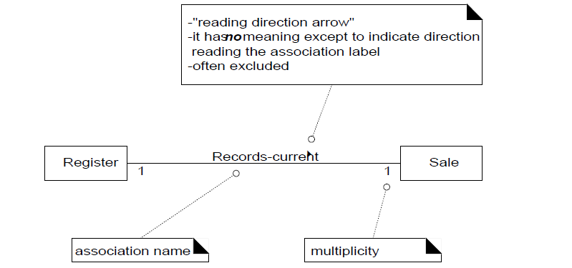

Slide 7
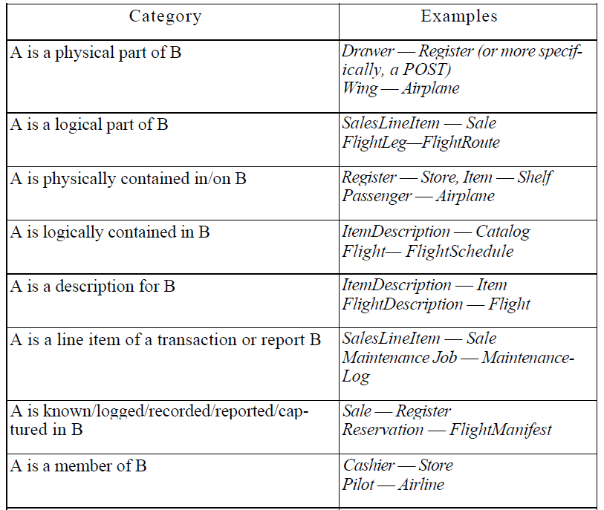

Slide 8
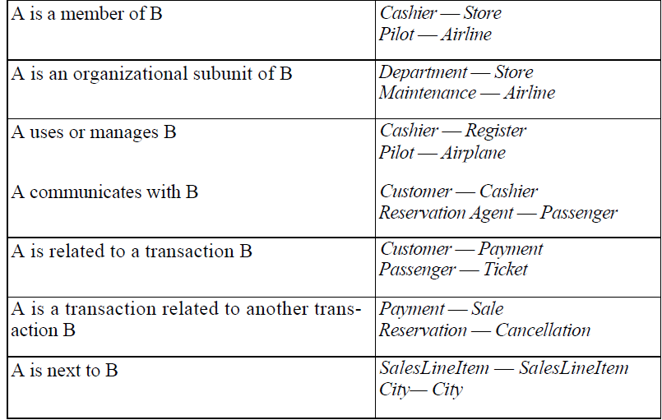

Slide 9
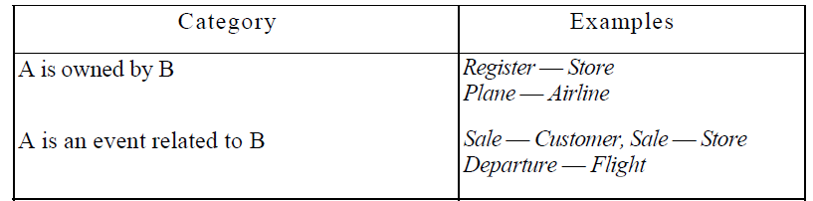

Slide 10

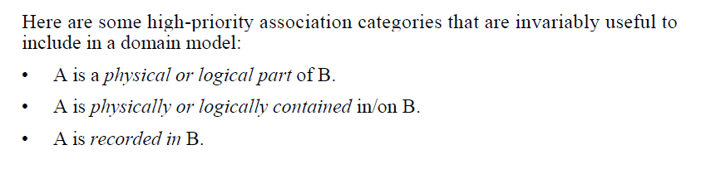

Slide 11

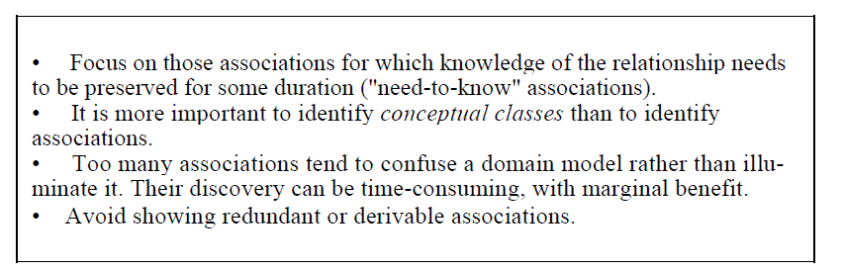

Slide 12

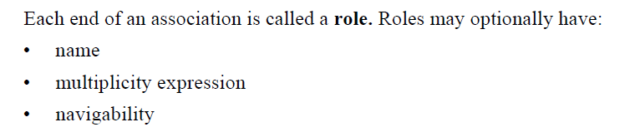

Slide 13

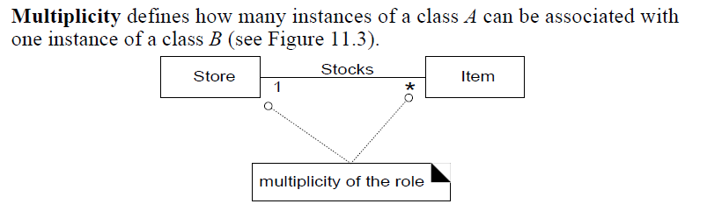

Slide 14
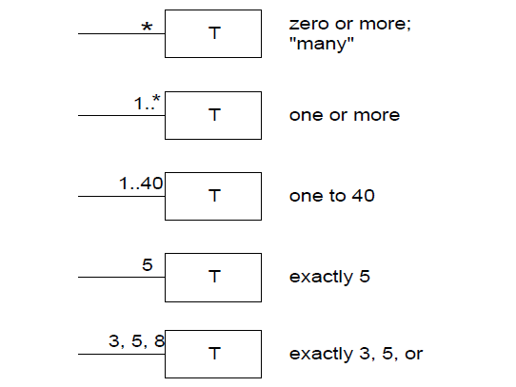

Slide 15
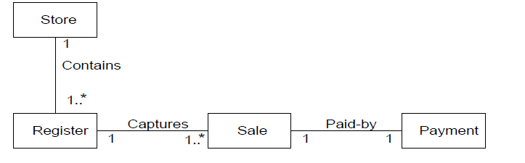

Slide 16
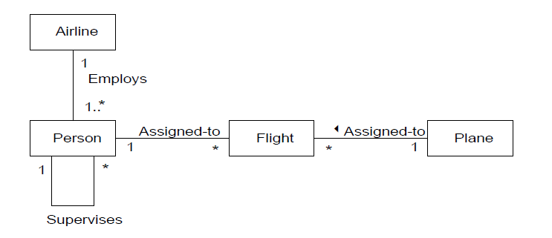

Slide 17
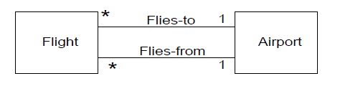

Slide 18
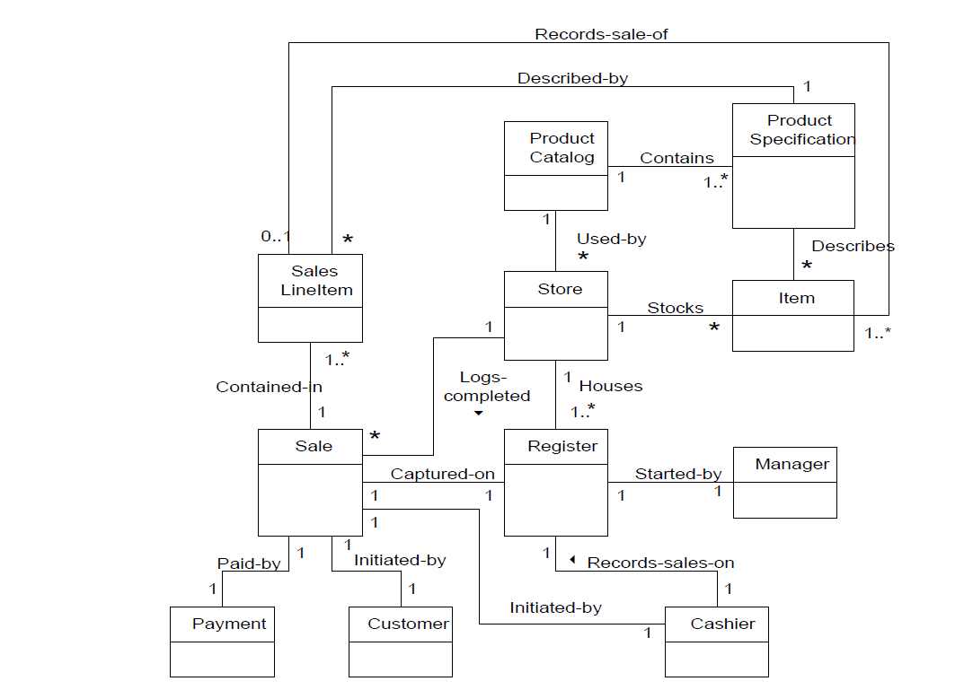

Slide 19
Reference
Chapter 11 Applying UML Patterns (Applying UML Patterns: An Introduction To Object-Oriented Analysis And Design) Craig L

